Slide 1
APT 38
Lazarus Group Aka The Chollima

Slide 2
Aliases and Goals
Aliases:
Main Goals:
This APT group is mainly financially motivated. They have targeted banks, financial institutions, casinos, cryptocurrency exchanges, SWIFT system endpoints, and ATMs in at least 38 countries worldwide.
Infiltrating foreign governments, particularly South Korea
APT38
Gods Apostles
Guardians of Peace
ZINC
Gods Disciples
Whois Team
Hidden Cobra

Slide 3
What is the relevance and overlap with North Korea as a State?
In terms of cybercrime groups, in North Korea, there seems to be a major overlap between different groups, the techniques used, as well as the support systems they rely on.
Some security researchers within the industry report all North Korean state-sponsored cyber activity under the name Lazarus Group instead of tracking clusters or subgroups.
The groups they are associated with, include Nickel Gladstone, BeagleBoyz, Bluenoroff and Stardust Chollima.
They operate financially, but they also have goals to target foreign governments, concentrating mainly on South Korea. This is characteristic of a Government backed Cybercrime group.

Slide 4
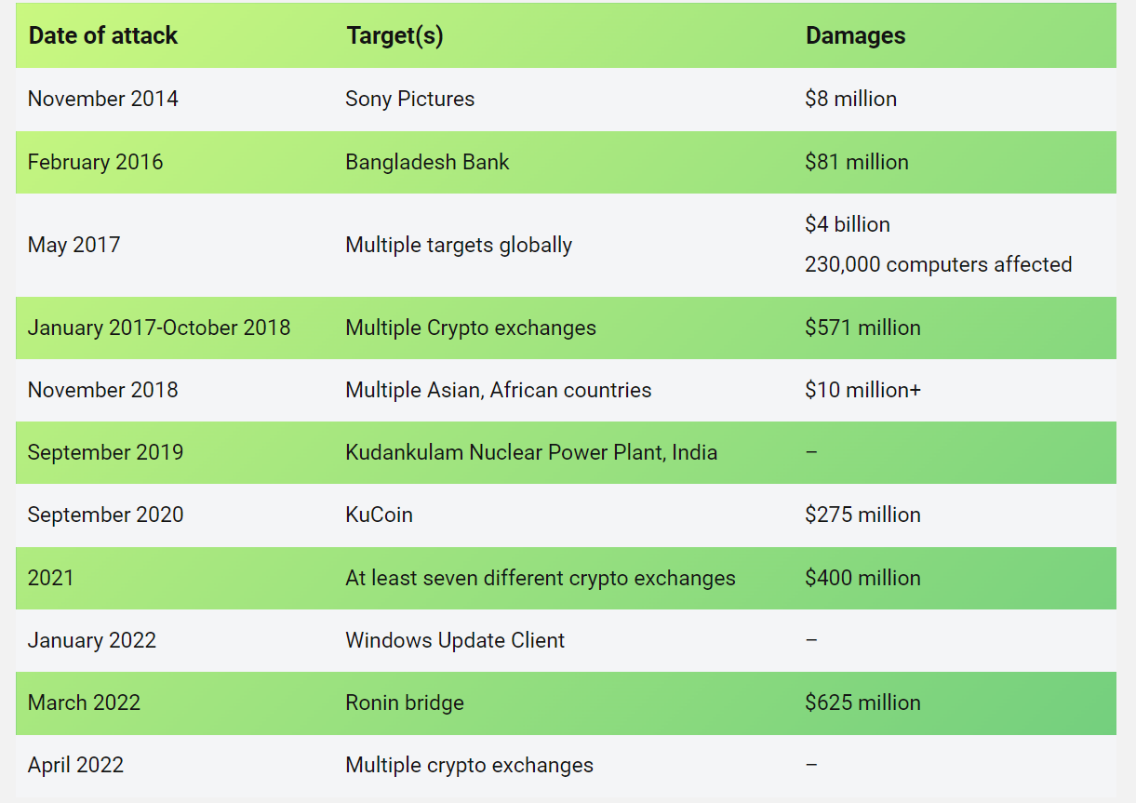
APT 38’s Financial Attack History

Slide 5
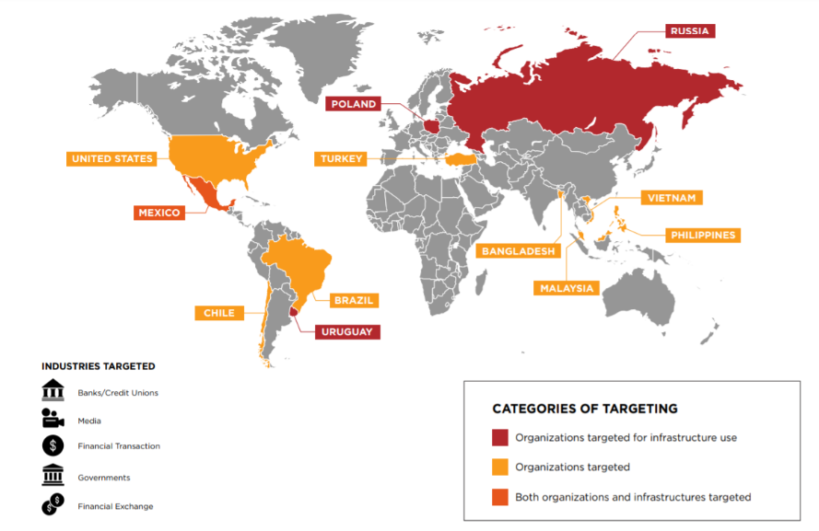
APT’s Worldwide Targets

Slide 6
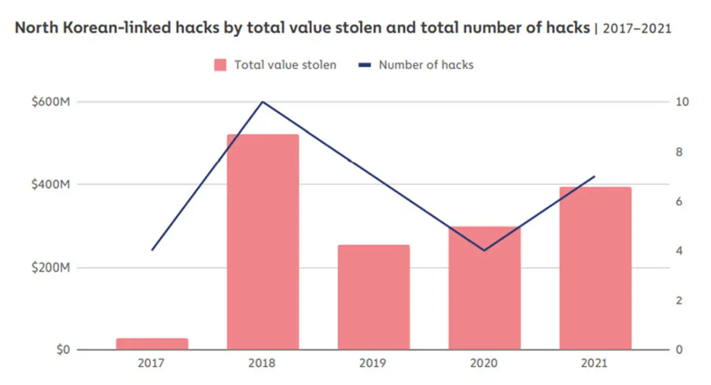

Slide 7
APT 38’s General Attacking Pattern
Information gathering: Targets accounts that can enable further access to targeted organizations.
Initial Compromise: Relies on watering hole attacks to gain initial access to at least some of its targets. Ex: exploited an insecure outdated version of Apache Struts2
Internal recon: Deploys malware to gather credentials and map the network
Pivot to the victim server: Deploys active and passive backdoors on target networks
Transfer funds: Uses malware allowing it to insert fraudulent SWIFT transactions and change transaction history
Destroy Evidence: Deletes logs and files using non-public malware. There have been instances of the group deploying and executing disk-wiping malware to get rid of any evidence as well.

Slide 8
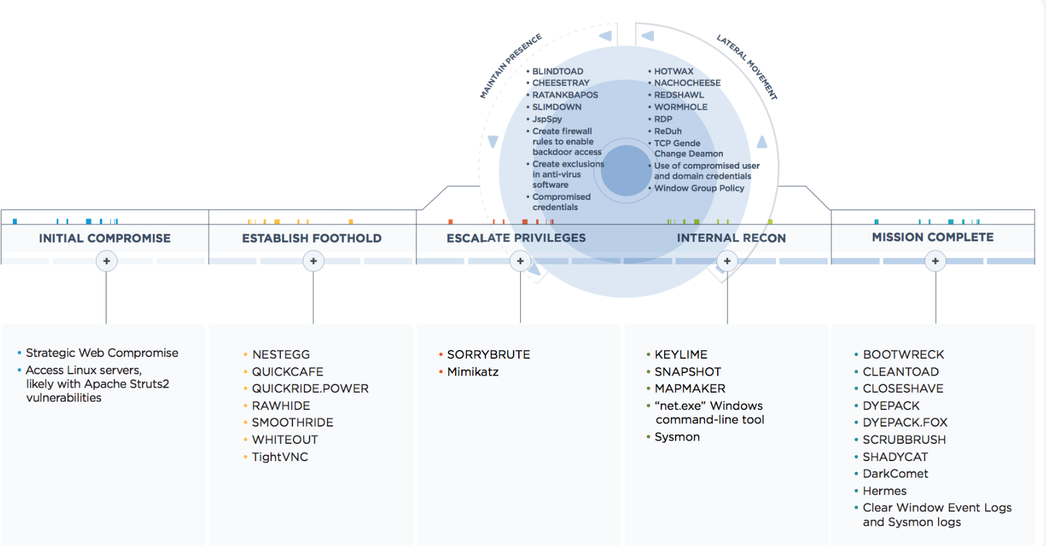
Attack Techniques and Tactics

Slide 9
APT 38 Characteristics and Capabilities
Made up of multiple operational groups primarily linked together with shared malware development resources and North Korean state sponsorship.
APT38 is characterized by long planning, extended periods of access to compromised victim environments preceding any attempts to steal money, fluency across mixed operating system environments, the use of custom developed tools, and a constant effort to thwart investigations capped with a willingness to completely destroy compromised machines afterwards.
The group is careful, calculated, and has demonstrated a desire to maintain access to a victim environment for as long as necessary to understand the network layout, required permissions, and system technologies to achieve its goals.
On average, APT38 remains within a victim network for approximately 155 days, with the longest time within a compromised environment believed to be almost two years.

